Slide 1
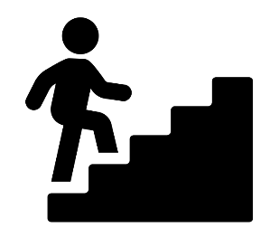
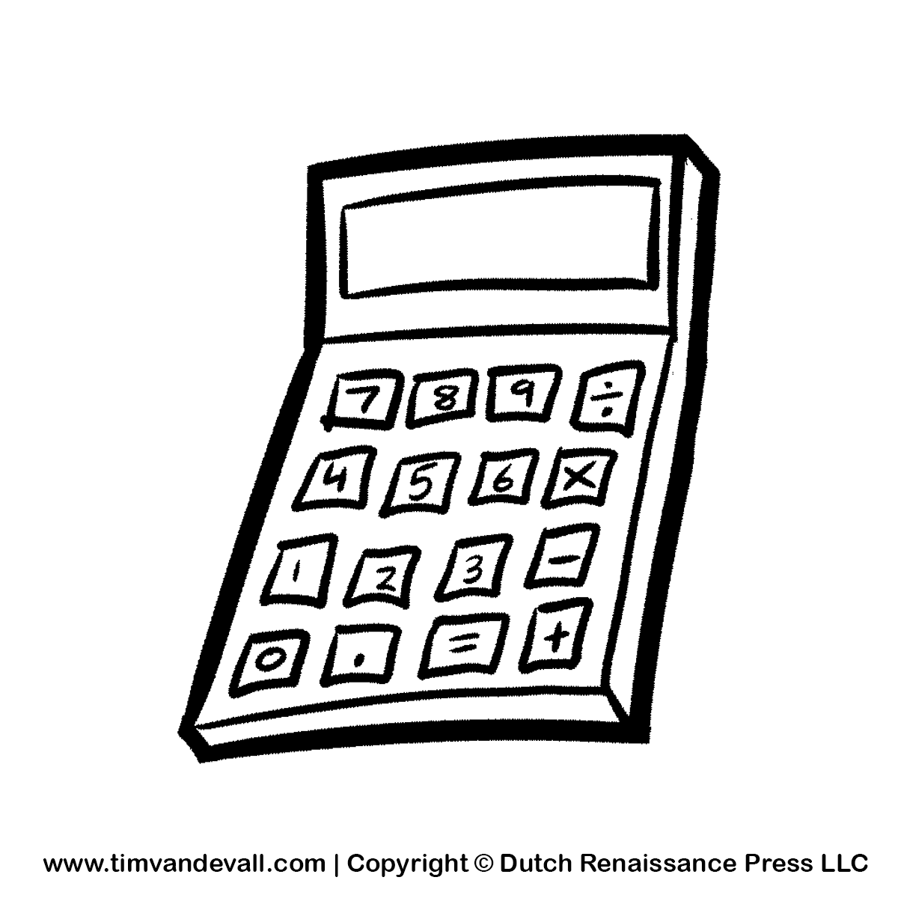
Identifying and understanding customer needs
DIGITAL INFORMATION TECHNOLOGY Learning Journey
DRAWING CONCLUSIONS
C2 C: DRAW CONCLUSIONS AND REVIEW
GRAPHS, CHARTS AND PIVOT TABLES
C3 EXAM RESIT, IF NEEDED
MACROS AND VALIDATION
MAKING RECOMMENDATIONS
SORTING AND FILTERING
POLICY, DATA PROTECTION, INTELLECTUAL PROPERTY RIGHTS
C3 D: PLANNING AND COMMUNICATION IN DIGITAL SYSTEMS
C2 B: CREATE A DASHBOARD USING DATA MANIPULATION TOOLS
SPREADSHEET AND FORMULAE
LEGAL REQUIREMENTS ANDS NET NEUTRALITY
C3 EXAM: EFFECTIVE DIGITAL WORKING PRACTICES
EQUAL ACCESS
FLOW CHARTS AND SYSTEM DIAGRAMS
DASHBOARDS AND IMPORTING DATA
C3 C: RESPONSIBLE, LEGAL AND ETHICAL USE
USER RESTRICTIONS
INTERNAL AND EXTERNAL THREATS
C3 B:THREATS TO DIGITAL SYSTEMS AND MANGING THAT THREAT
IMPACT OF TECHNOLOGY ON THE ENVIRONEMNT
ACTIONS AFTER AN ATTACK
SHARING DATA
WEAKNESSES AND SECURITY POLICIES
DATA LEVEL PROTECTION
Ethics, the environment and business
WHY SYSTEMS ARE ATATCKED
YEAR
11
C3 A:MOEDERN TECHNOLOGIES AND THEIR IMPACT ON ORGANISATIONS
CLOUD STORAGE & COMPUTING
COLLABORATIVE TECHNIQUES
IMPACT ON INDIVIDUALS
Data security
Data modelling
COMMUNICATION TECHNOLOGIES
PLATFORMS & SERVICES
COMMUNICATION AND ACCESSIBILITY
QUALITY OF DATA
COLLECTING DATA
DATA AND INFORMATION
C2 A: INVESTIGATE THE ROLE AND IMPACT OF USING DATA ON INDIVIDUALS
PROCESSING AND PRESENTING DATA
REVIEW PROJECT PLANNING TECHNIQUES
C1 C: DEVELOP AND REVIEW A USER INTERFACE
DEVELOP A FUNCTIONAL USER INTERFACE
CONSTRAINTS AND RISKS
Key aspects of user interfaces
REFINE AND REVIEW
GANTT CHARTS
CPA
PERT CHARTS
DESIGN PRINCIPLES WITH USER EXPECTAION AND ENGAGMENT
C1 A: INVESTIGATE USER INTERFACE DESIGN
PROJECT METHODOLOGIES
HARDWARE AND SOFTWARE
PLANNING TOOLS AND PROJECT REQUIREMENTS
YEAR
10
C1 B: USE PROJECT PLANING TECHNIQUES TO PLAN AND DESIGN A USER INTERFACE
USER ACCESSIBILITY, SKILLS AND DEMOGRAPHICS
BASIC AND COMPLEX USER INTERFACES

