Slide 1
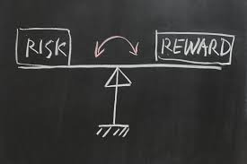
Identifying and understanding customer needs
GCSE Business 9-1 Learning Journey
Motivation
Effective recruitment
2.5 Making Human Resource decisions
Effective training and development
Organisational structures
Understanding business performance
Working with suppliers
2.4 Making financial decisions
2.3 Making operational decisions
Business operations
Managing quality
Business calculations
Place
Price
Topic 2.2 Making marketing decisions
Business and globalisation
Using the marketing mix to make business decisions
Business growth
Promotion
Product
Ethics, the environment and business
Changes in business aims and objectives
The economy and business
Topic 2.1 Growing the business
Technology and business
YEAR
11
Topic 1.5 Understanding External Influences
Business stakeholders
Legislation and business
External influences
The marketing mix
The options for start-up and small businesses
Topic 1.4 Making the business effective
Business plans
Business location
Cash and cash-flow
The competitive environment
Topic 1.3 Putting a business idea into practice
Business aims and objectives
Market segmentation
Business revenues, costs and profits
Sources of business finance
Market research
Topic 1.2 Spotting a business opportunity
Risk and reward
Topic 1.1 Enterprise and entrepreneurship
YEAR
10
Customer needs
The role of business enterprise
The dynamic nature of business

