Slide 1
GCSE Options
Please also refer to the Options Booklet

Slide 2
KEY DATES
Thurs 11th December 2025 | Year 9 reports went home.
Mon 5th & Tue 6th January 2026 | Year 9 assemblies and input from Exeter College End of the week – all information sent home.
Mon 5th – Wed 28th January 2026 | Teachers provide information about their courses during subject lessons.
Thurs 15th January 2026 | Year 9 Parents’ Evening & Options talk.
Thurs 15th January 2026 PM | Students’ instructions on accessing the Online Options system sent to all Parents/Carers and students. Online Options opens.
Thurs 29th January 2025 11:00 AM | Online Option system closes.
After 29th January 2025 | Parents sent an EduLink survey to fill in once their child has completed their options. Any changes come through Mr Twelves. Clashes dealt with by Mr Twelves. Students find out which options they have by Summer 2026. End of Year 9/Key Stage 3 reports out 15th July 2026

Slide 3
The Core Subjects
GCSE English (Language and Literature)
GCSE Mathematics
GCSE Science (Combined Trilogy – worth 2 GCSEs)
GCSE RE (Short Course) or Higher Project
Core PE (No Exam)
PSHE (No Exam)
Subject | Year 10 | Year 11
English | 7hrs | 7hrs
Mathematics | 7hrs | 7hrs
Science | 8hrs | 10hrs
GCSE RE Short Course | 2 hrs | N/A
Core PE | 4hrs | 4 hrs
PSHE | 2 hrs | 2hrs
The King’s

Slide 4
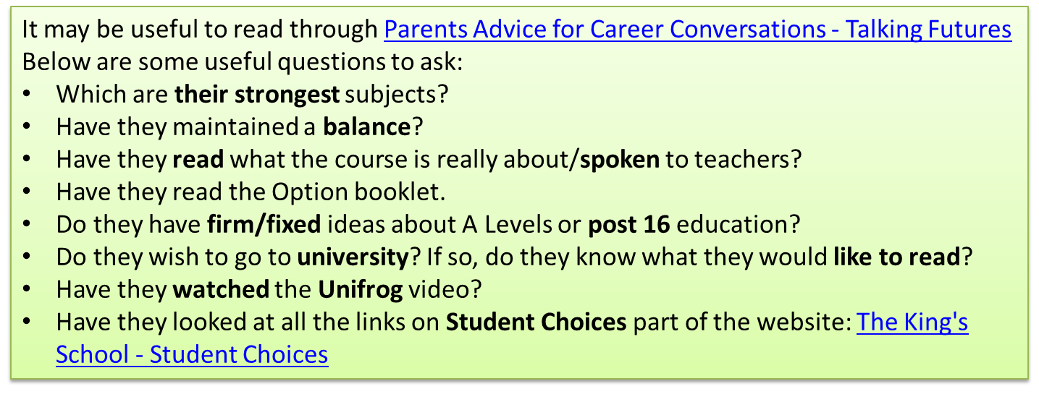

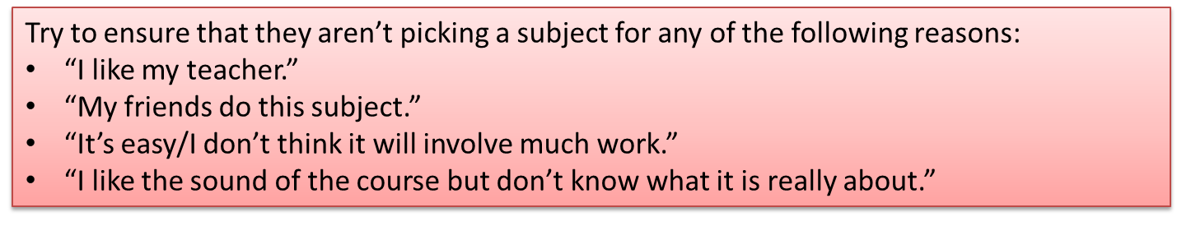
When choosing your options…..
The King’s
Notes:
Luke

Slide 5
Reason why students in the past haven’t chosen a subject they liked. | Reality
No friends were taking it – chose a subject that they didn’t like as much to be with their friend(s). | Two years – 5 periods/fortnight – a lot of lessons to be in a subject that you don’t like. Everything mixed up in year 10 to allow options to work. You could choose all the same subjects as your friend and not end up in the same groups.
It sounded like a lot of work. | All GCSEs are academic. All are Level 2 courses. Some more exam-based other subject pressures come at different times through NEAs etc. No easy option! Have you really looked at what the course involves?
Didn’t get on with the teacher in year 9. | You have no control over who teaches you in year 10 In a group with other students who want to do the subject your rapport with the teacher could change. You must pick the subject NOT the teacher.
Never thought that the subject would be useful later on. | Aim for a broad, balanced range of subjects. Picking a humanity, a science, a creative/practical subject and a language will never hold you back. 14 is very early to close the door on any career path.

Slide 6
Some examples of where students haven’t chosen wisely.
Scenario | Issues – all avoidable by looking at the resources/chatting to teachers.
Business: New, different, easy subject. Dislikes maths. | Maths is an integral part of the course. Two papers at the end of the course where theory must be applied.
Separate Sciences: Couldn’t think of a 4th option and doesn’t mind science. Dislikes maths. | Taking separate science means c.30% of timetable is in science. Maths skills make up 10% of the Biology paper, 20% of the Chemistry and 30% of the Physics paper.
Expressive Arts - e.g: Drama: Enjoying year 9 drama with Mrs… Doesn’t like performing in front of others. No interest in the theory side. | Didn’t look at the course content – Performance is 60%. 40% is a written exam where theory must be applied. Ends up getting taught by another teacher – no choice.
PE GCSE: Likes sport –as fun. Dislikes science. | 60% = 2 x written papers applying theory including anatomy and physiology. Practical component is skills based not just fun.
History: Like finding out about the past – especially WW1. | They didn’t look at the content – the modern depth study starts in 1918 (after WW1)

Slide 7
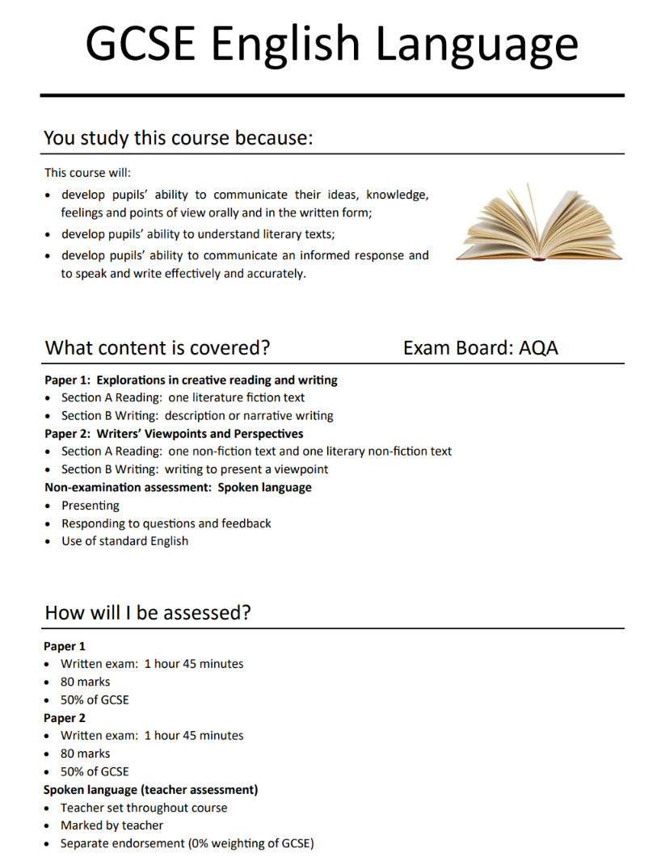
Example from the Options Booklet
Read this booklet carefully
1st section = why do the course?
2nd section = what content is covered?
3rd section = how will students be tested? Written/NEA?

Slide 8
The Option Subjects
Pick 4 & 2 reserves
Art | Business | Computer Science
Dance | Drama | Textile Design
D&T - Electronics & Mechanisms | D&T- Materials | Food Preparation & Nutrition
French | Geography | History
IT Technical Award -Digital Applications | Music | Physical Education
Religious Studies | Spanish | Skills for Learning courses (by invite only)
Separate Sciences (down as Triple Science on the Options programme)
The King’s
Teaching time: 5 hrs/fortnight.

Slide 9
Option combinations
Your child's option choices should be broad and balanced enabling them to pick subjects that are of an interest to them, whilst ensuring that they have the necessary key skills for a successful future.
We strongly recommend that they consider studying:
  at least one Humanities subject;
  a Language;
  Two options from:
    Creative, Design & Technology, Practical or Sciences.
The King’s

Slide 10
The Review is clear that schools should promote a curriculum at Key Stage 4 that is
appropriately broad and balanced, enabling young people to pursue their interests
and passions whilst ensuring uptake of the subjects that are most likely to support life
chances and the needs of our society and economy. This should include a strong
academic core for all.
The combination of the Maths and English bucket, plus the existing EBacc bucket,
ensures that, in practice, young people must take English (taking English Language and
Literature is incentivised), Maths and (at least Combined) Science, which are mandatory
subjects, plus one other EBacc subject, such as History, Geography or a Language.
Students are then able to select any other approved qualification. Typically, this will
be a further three subjects if the student is taking nine qualifications, the most common
number at Key Stage 4. We think that this represents a desirable balance between
breadth and choice, securing both the academic core that is so important for young
people’s life chances but also the flexibility they need to support and reflect their diverse interests and desired pathways.

Slide 11

Creative
Art
Textile Design
Dance
Drama
Music
Only one of these two options can be chosen
The King’s
Notes:
Luke

Slide 12

DESIGN TECHNOLOGY – more information
Design & Technology Group 1:
GCSE Food Preparation & Nutrition
Design & Technology Group 2:
GCSE Design & Technology: Materials
GCSE Design & Technology: Electronics & Mechanisms
ONLY ONE OF THE SUBJECTS FROM GROUP 2 CAN BE CHOSEN!
They CAN select Food Preparation & Nutrition AND a Design technology GCSE. They are UNLIKELY to get both.
The King’s

Slide 13
Humanities
GCSE Geography
GCSE History
GCSE Religious Studies (Full Course)
Full course RPE students also complete the Higher Project
The King’s
Notes:
Luke

Slide 14
Languages
GCSE French
or
GCSE Spanish
The King’s
Notes:
Luke

Slide 15
Practical/Vocational
Business
IT Technical Award in Digital Applications
PE GCSE
The King’s
Notes:
Luke

Slide 16
Sciences
Computer Science
Separate Sciences – 3 GCSEs. The core Science offering (Combined Trilogy) is worth 2 GCSEs.
The King’s
Notes:
Luke

Slide 17
Combined or Separate Sciences?
Both routes are valued equally by colleges, sixth forms, and universities, and both give your child the foundation needed to study A-Level Sciences in the future.
Separate Sciences
We strongly recommend your child talks this through with their teacher.
Combined Trilogy
Combined Science is a balanced option that still gives them strong knowledge across Biology, Chemistry, and Physics, while keeping space for other GCSE subjects. They gain two GCSEs in Combined Science.
If they are unsure about pursuing a career in science, want a broad science education without the intensity of Separate Sciences, or if they want to keep more GCSE options open, the Combined Science course is better for them.
Separate Sciences cover more content in greater depth. This is an excellent choice if they enjoy Science, want the challenge of exploring topics in more detail, and feel confident applying their Maths skills to scientific problems. They gain three GCSEs in Biology, Chemistry and Physics.
A passion for Science is needed.

Slide 18
Reserve choices
Options form is a ‘free choice’.
But:
  Some options may not run if there are too few people who choose it
  Some options may become full. Think carefully about the order your child puts their options in. 1= the subject you really want to do!
  Some subjects could clash when they are put into blocks.
Select TWO reserve choices.
Think carefully about their reserve choices.
Put their reserve choices in order of preference.
The King’s

Slide 19
Completing online Options
Full step-by-step instructions will be sent out for students via EduLink. The instructions must be followed carefully. Help is available, after Online Options has opened, in Computer Science lessons. If in doubt, wait for this lesson.
Students will need to access their school email www.office.com and they will be the ones selecting their options and their reserves.
Parents/carers, you will be sent an EduLink survey to approve your option choices. You will need to see your child’s online options before completing the survey.
The King’s
Notes:
Luke

Slide 20
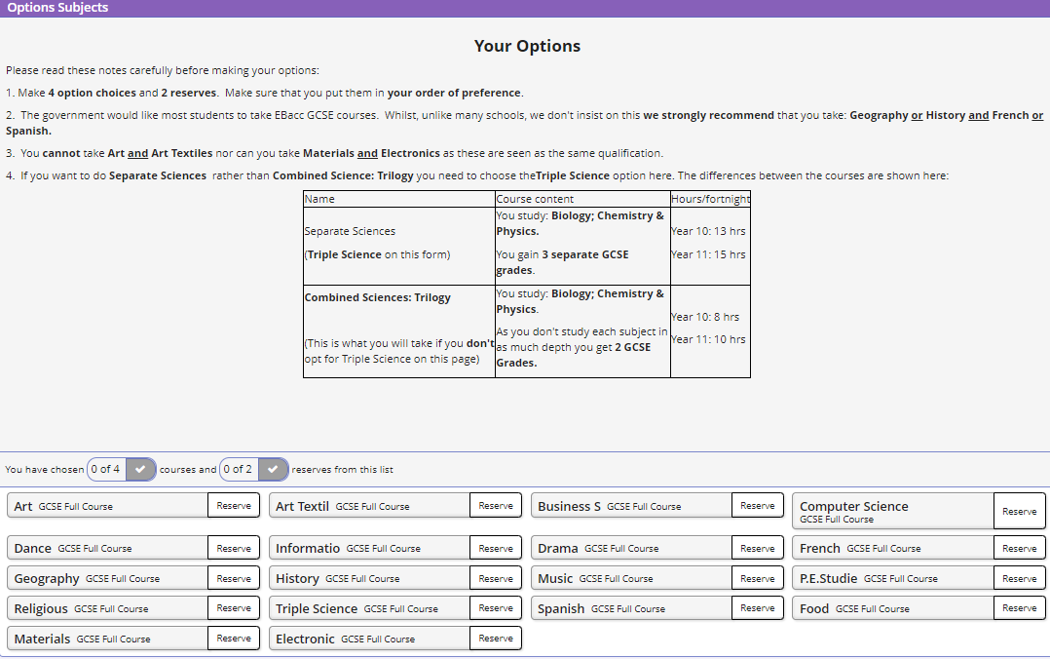
Students: Please read the onscreen instructions!
Click on the subject to select it as your main option. Click on it again to cancel it
Click on ‘Reserve’ to put a subject as your reserve option.

Slide 21
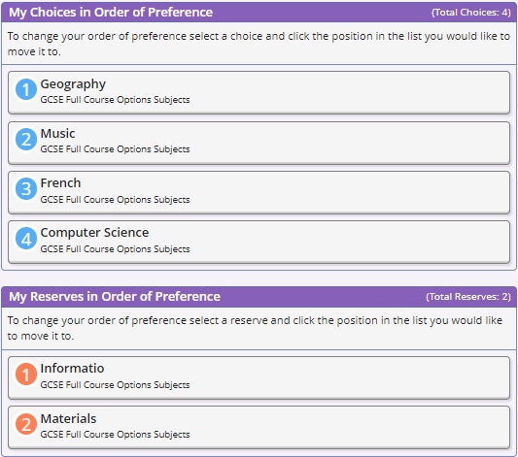
Please note the order of preference. Follow the instructions if you wish to change the order

Slide 22
www.sims-options.co.uk
Once students have registered, by going to this website address they can make/amend their options.
Parents/Carers must complete their EduLink survey having seen the chosen options.
After this date changes will:
  have to go through Mr Twelves;
  will be harder as Option blocks will be created based on students' initial options.
Deadline - 29th January

Slide 23
Who to speak to……..
Your child's teachers- subject areas will be giving presentations in lesson time.
Tutors
Parents/carers
Mrs Dighton – SENDCO – Please speak to regarding any of the invitation courses.
Mr Twelves - please direct any queries about the process to Mr Twelves (ntwelves@thekings.devon.sch.uk)
The King’s

Slide 24
KEY DATES
Thurs 11th December 2025 | Year 9 reports went home.
Mon 5th & Tue 6th January 2026 | Year 9 assemblies and input from Exeter College End of the week – all information sent home.
Mon 5th – Wed 28th January 2026 | Teachers provide information about their courses during subject lessons.
Thurs 15th January 2026 | Year 9 Parents’ Evening & Options talk.
Thurs 15th January 2026 PM | Students’ instructions on accessing the Online Options system sent to all Parents/Carers and students. Online Options opens.
Thurs 29th January 2025 11:00 AM | Online Option system closes.
After 29th January 2025 | Parents sent an EduLink survey to fill in once their child has completed their options. Any changes come through Mr Twelves. Clashes dealt with by Mr Twelves. Students find out which options they have by Summer 2026. End of Year 9/Key Stage 3 reports out 15th July 2026

